Slide 1

Programming Two (csc7051)
Aidan McGowan
Java Collections Framework

Slide 2
Collections - introduction
A collection — sometimes called a container — is simply an object that groups multiple elements into a single unit.
Collections are used to store, retrieve, manipulate and communicate aggregate data.
Typically, they represent data items that form a natural group, such as a poker hand (a collection of cards), a mail folder (a collection of letters), or a telephone directory (a mapping of names to phone numbers).

Slide 3
History
Collection implementations in pre-JDK 1.2 versions of the Java platform included some data structure classes, but did not contain a collections framework.
The standard methods for grouping Java objects were via the array, the Vector, and the Hashtable classes, which unfortunately were not easy to extend and did not implement a standard member interface.

Slide 4
History
To address the need for reusable collection data structures, several independent frameworks were developed, the most used being a Collections package and ObjectSpace Generic Collection Library (JGL).
The Collections framework was designed and developed and was introduced in JDK 1.2.

Slide 5
What is the Collections framework
A collections framework is a unified architecture for representing and manipulating collections. All collections frameworks contain the following:
  Interfaces
  Implementations
  Algorithms

Slide 6
Collections - Interfaces
These are Abstract Data Types that represent collections.
Interfaces allow collections to be manipulated independently of the details of their representation.
In object-oriented languages, interfaces generally form a hierarchy.

Slide 7
Collections - Implementations
These are the concrete implementations of the collection interfaces.
In essence, they are reusable data structures.
These include, ArrayList, LinkedList, HashSet, TreeSet, PriorityQueue Hashtable, HashMap, TreeMap …

Slide 8
Algorithms
These are the methods that perform useful computations, such as searching and sorting, on objects that implement collection interfaces.
The algorithms are said to be polymorphic: that is, the same method can be used on many different implementations of the appropriate collection interface. In essence, algorithms are reusable functionality.

Slide 9
Benefits of the Java Collection Framework- what is in it for you ?
Reduces programming effort
  By providing useful data structures and algorithms, the Collections Framework frees you to concentrate on the important parts of your program rather than on the low-level "plumbing" required to make it work. By facilitating interoperability among unrelated APIs, the Java Collections Framework frees you from writing adapter objects or conversion code to connect APIs.

Slide 10
Benefits of the Java Collection Framework- what is in it for you ?
Increases program speed and quality
  The Collections Framework provides high-performance, high-quality implementations of useful data structures and algorithms. The various implementations of each interface are interchangeable, so programs can be easily tuned by switching collection implementations. Because you're freed from the drudgery of writing your own data structures, you'll have more time to devote to improving programs' quality and performance.

Slide 11
Benefits of the Java Collection Framework- what is in it for you ?
Allows interoperability among unrelated APIs
  The collection interfaces are the vernacular by which APIs pass collections back and forth. If my network administration API furnishes a collection of node names and if your GUI toolkit expects a collection of column headings, our APIs will interoperate seamlessly, even though they were written independently.

Slide 12
Benefits of the Java Collection Framework- what is in it for you ?
Reduces effort to learn and to use new APIs
  Many APIs naturally take collections on input and furnish them as output. In the past, each such API had a small sub-API devoted to manipulating its collections. There was little consistency among these ad hoc collections sub-APIs, so you had to learn each one from scratch, and it was easy to make mistakes when using them. With the advent of standard collection interfaces, the problem went away.

Slide 13
Benefits of the Java Collection Framework- what is in it for you ?
Reduces effort to design new APIs
  This is the flip side of the previous advantage. Designers and implementers don't have to reinvent the wheel each time they create an API that relies on collections; instead, they can use standard collection interfaces.

Slide 14
Benefits of the Java Collection Framework- what is in it for you ?
Fosters software reuse
  New data structures that conform to the standard collection interfaces are by nature reusable. The same goes for new algorithms that operate on objects that implement these interfaces.

Slide 15
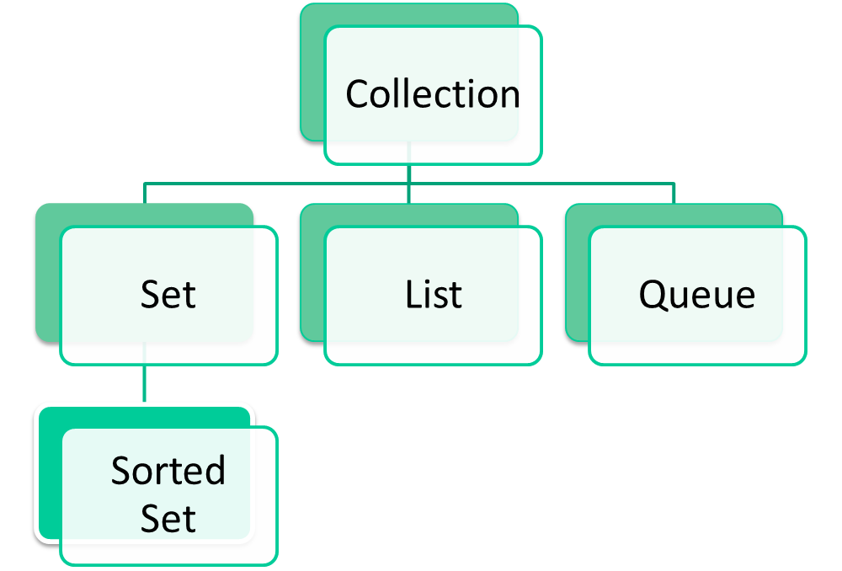
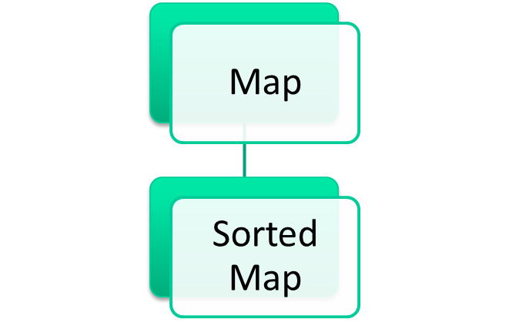
The Collections Framework

Slide 16
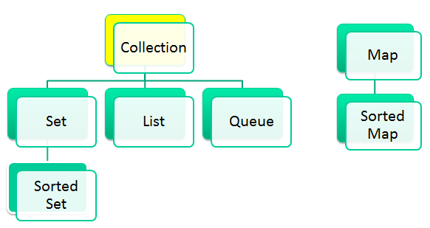
Collection
The root of the collection hierarchy.
A collection represents a group of objects known as its elements.
It is an Interface – you can’t instantiate it.
The Collection interface is the least common denominator that all collections implement and is used to pass collections around and to manipulate them when maximum generality is desired.

Slide 17
Collection
Some types of collections allow duplicate elements, and others do not. Some are ordered and others are unordered.
The Java platform doesn't provide any direct implementations of this interface but provides implementations of more specific subinterfaces, such as Set and List.

Slide 18
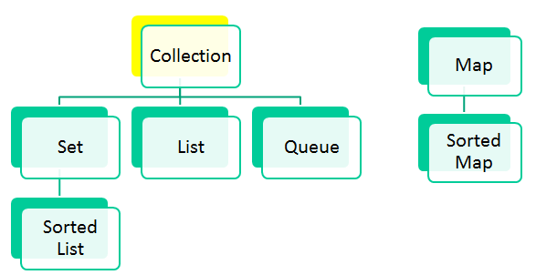
Collection
By convention all general-purpose collection implementations (Lists, Sets etc.) have a constructor that takes a Collection argument.
This constructor, known as a conversion constructor, initialises the new collection to contain all of the elements in the specified collection, whatever the given collection's subinterface or implementation type. In other words, it allows you to convert the collection's type.

Slide 19
Collection
The interface provides the following methods…
http://docs.oracle.com/javase/8/docs/api/java/util/Collection.html
Methods that operate on single collections size, isEmpty, contains, add, remove and iterator.
Methods that operate on entire collections, containsAll addAll, removeAll, retainAll and clear.
Methods for array operations (such as toArray)

Slide 20
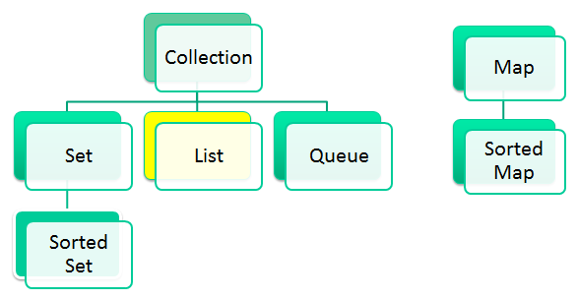
List
An ordered collection (sometimes called a sequence).
Lists can contain duplicate elements.
The user of a List generally has precise control over where in the list each element is inserted and can access elements by their integer index (position).
The Java platform contains two general-purpose List implementations.
  ArrayList, which is usually the better-performing implementation
  LinkedList which offers better performance under certain circumstances.

Slide 21
List
In addition to the operations inherited from Collection, the List interface includes operations for the following:
  Positional access — manipulates elements based on their numerical position in the list. This includes methods such as get, set, add, addAll, and remove.
  Search — searches for a specified object in the list and returns its numerical position. Search methods include indexOf and lastIndexOf.
  Iteration — extends Iterator semantics to take advantage of the list's sequential nature. The listIterator methods provide this behaviour.
  Range-view — The sublist method performs arbitrary range operations on the list.
Notes:
With iterator you can move only forward, but with List Iterator you can move back word also while reading the elements.
With List Iterator you can obtain the index at any point while traversing, which is not possible with iterators.
With iterator you can check only for next element available or not, but in list iterator you can check previous and next elements.
With list iterator you can add new element at any point of time, while traversing. Not possible with iterator.
With list iterator you can modify an element while traversing, which is not possible with iterator.
List<Integer> list1 = new ArrayList<>();
list1.add(1);
list1.add(2);
list1.add(3);
// List iterator
ListIterator<Integer> listIt = list1.listIterator(list1.size());
// show last item
while (listIt.hasPrevious()){
System.out.println(listIt.previous());
}

Slide 22
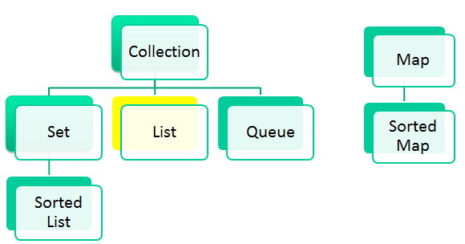
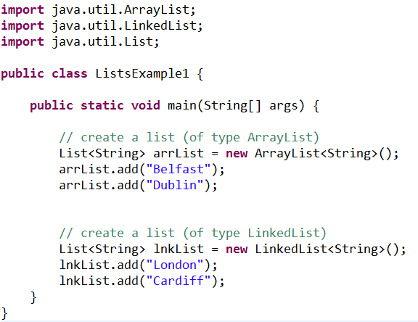
List
Creating an ArrayList
Creating a LinkedList

Slide 23
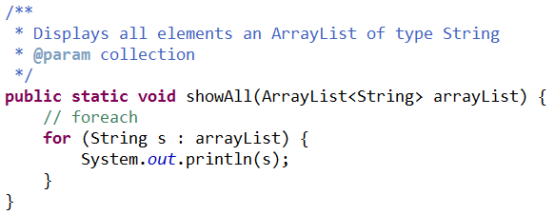
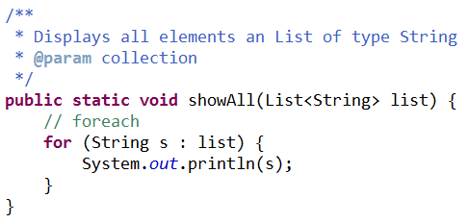
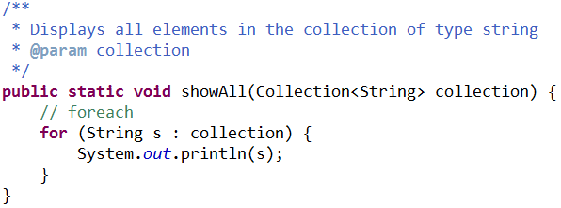
List – parameter passing
(programming to interfaces)
Parameter argument defined as an ArrayList
Parameter argument defined as a List
Parameter argument defined as a Collection

Slide 24
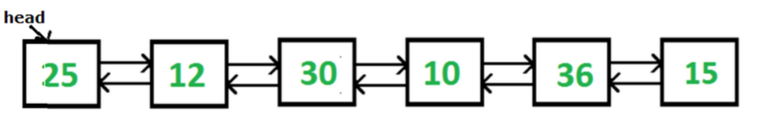
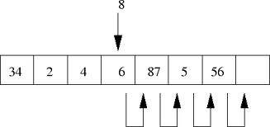
List
LinkedList and ArrayList are two different implementations of the List interface.
LinkedList implements
it with a doubly-linked list.
ArrayList Implements it
with a dynamically resizing array.

Slide 25
List
ArrayList vs. LinkedList Performance
  Linked List allows for constant-time insertions or removals using iterators, but only sequential access of elements. In other words, you can walk the list forwards or backwards, but finding a position in the list takes time proportional to the size of the list.
  ArrayList allows fast random read access, so you can grab any element in constant time. But adding or removing from anywhere but the end requires shifting all the latter elements over, either to make an opening or fill the gap.

Slide 26
List - exercise
Remove duplicates exercise
Create an arraylist and a linked list. Populate both lists with 10 random numbers (value range 1-5)
Complete the following method …
public static void removeDuplicates(Collection<Integer> originalList, Collection<Integer> listToRemove)
The originalList passed as a parameter will have any items removed from it that exist in the second list (listToRemove)
Notes:
public static void removeDuplicates(Collection<Integer> originalList,
Collection<Integer> listToRemove) {
for (Integer removeItem : listToRemove){
if (originalList.contains(removeItem)){
originalList.remove(removeItem);
}
}
}

Slide 27
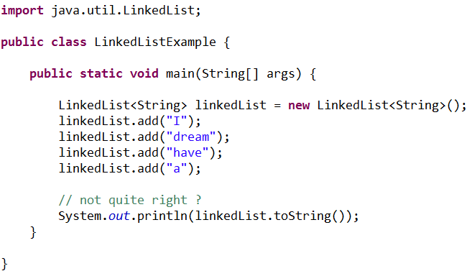
List – exercise
LinkedList - swap elements
Create a method to swap elements in an List, given the following method signature to reorder the output to
Notes:
public static void main(String[] args) {
LinkedList<String> linkedList = new LinkedList<String>();
linkedList.add("I");
linkedList.add("dream");
linkedList.add("have");
linkedList.add("a");
// not quite right ?
System.out.println(linkedList.toString());
swap(linkedList, 1, 2);
System.out.println(linkedList.toString());
swap(linkedList, 2, 3);
System.out.println(linkedList.toString());
}
public static void swap(List<String> list, int position1, int position2){
String tmp = list.get(position1);
list.set(position1, list.get(position2));
list.set(position2, tmp);
}

Slide 28
Collections Framework – Algorithms
Most polymorphic algorithms in the Collections class apply specifically to List.
Having all these algorithms at your disposal makes it very easy to manipulate lists.
Here's a summary of these algorithms...

Slide 29
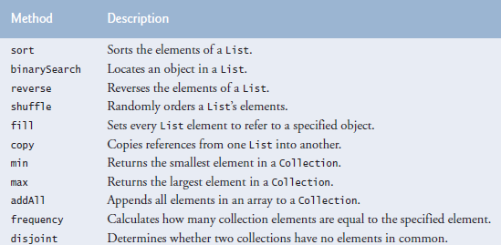
Collections class
Class Collections provides static methods that search, sort and perform other operations on collections. Methods provided by Collections
http://docs.oracle.com/javase/7/docs/api/java/util/Collections.html
Notes:
http://docs.oracle.com/javase/8/docs/api/java/util/Collections.html
Summary –
LinkedList<Integer> linkedList = new LinkedList<Integer>();
linkedList.add(333);
linkedList.add(2);
linkedList.add(89);
linkedList.add(8282);
linkedList.add(8282);
System.out.println(linkedList.toString());
// sort
Collections.sort(linkedList);
System.out.println(linkedList.toString());
// reverse
Collections.reverse(linkedList);
System.out.println(linkedList.toString());
// shuffle
Collections.shuffle(linkedList);
System.out.println(linkedList.toString());
// min
System.out.println("Min value : "+Collections.min(linkedList));
// max
System.out.println("Max value : "+Collections.max(linkedList));
// frequency
System.out.println("Frequency value (8282) in the list : "+Collections.frequency(linkedList, 8282));

Slide 30
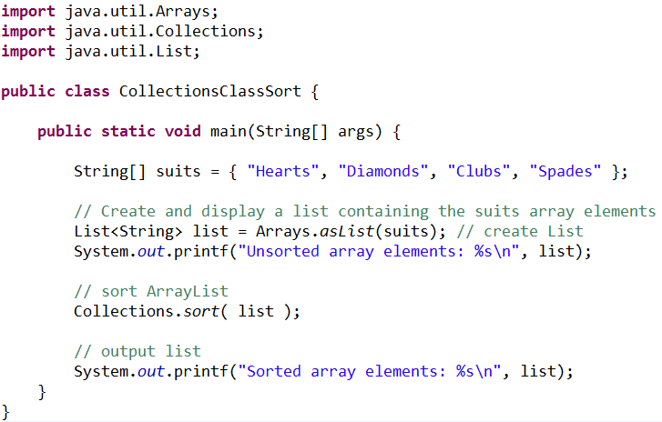
Collections class - sort
Prints out its arguments in lexicographic (alphabetical) order
http://docs.oracle.com/javase/7/docs/api/java/util/Collections.html
Notes:
The sort operation uses a slightly optimized merge sort algorithm that is fast and stable:
Fast: It is guaranteed to run in n log(n) time and runs substantially faster on nearly sorted lists. Empirical tests showed it to be as fast as a highly optimized quicksort. A quicksort is generally considered to be faster than a merge sort but isn't stable and doesn't guarantee n log(n) performance.
Stable: It doesn't reorder equal elements. This is important if you sort the same list repeatedly on different attributes. If a user of a mail program sorts the inbox by mailing date and then sorts it by sender, the user naturally expects that the now-contiguous list of messages from a given sender will (still) be sorted by mailing date. This is guaranteed only if the second sort was stable.

Slide 31
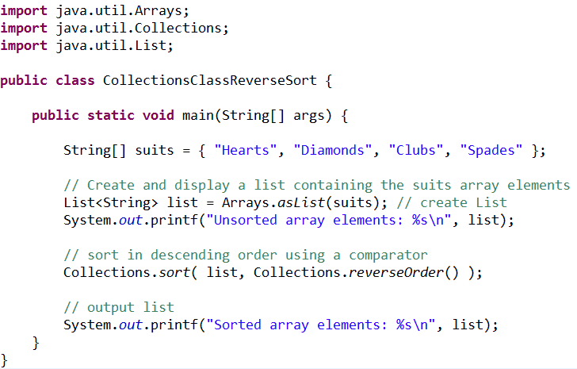
Collections class – reverse sort
The example introduces the Comparator interface, which is used for sorting a Collection’s elements in a different order. The call to the Collection class sort method is to order the List in descending order. The static Collections method reverseOrder returns a Comparator object that orders the collection’s elements in reverse order.

Slide 32
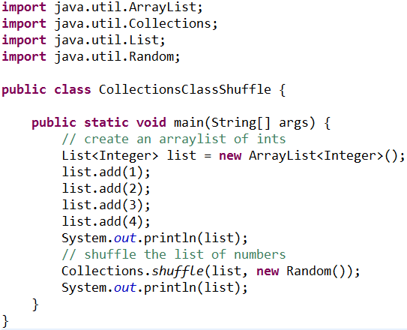

Collections class - shuffle

Slide 33
Collections class - Routine Data Manipulation
Reverse
  reverses the order of the elements in a List.
Fill
  overwrites every element in a List with the specified value. This operation is useful for reinitializing a List.
Copy
  takes two arguments, a destination List and a source List, and copies the elements of the source into the destination, overwriting its contents.
Swap
  swaps the elements at the specified positions in a List.
AddAll
  adds all the specified elements to a Collection. The elements to be added may be specified individually or as an array.

Slide 34
Collections class - Search
The binarySearch algorithm searches for a specified element in a sorted List.
This algorithm has two forms.
  The first takes a List and an element to search for (the "search key"). This form assumes that the List is sorted in ascending order according to the natural ordering of its elements.
  The second form takes a Comparator in addition to the List and the search key, and assumes that the List is sorted into ascending order according to the specified Comparator. The sort algorithm can be used to sort the List prior to calling binarySearch.

Slide 35
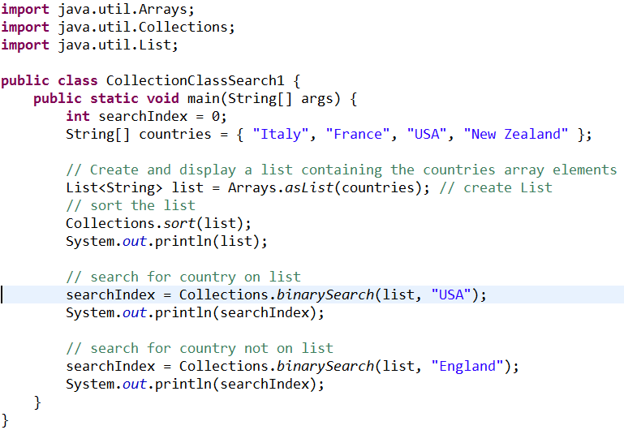

Collections class - Search

Slide 36
Collections class - Search

Slide 37
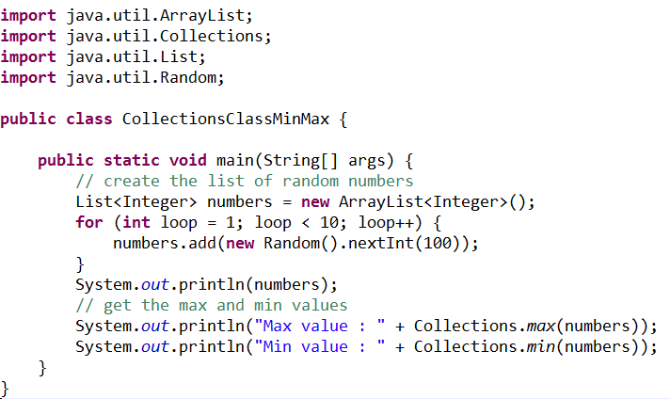

Collections class – Min and Max

Slide 38
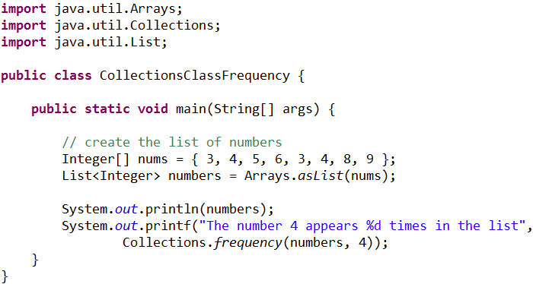

Collections class – Composition
The frequency and disjoint algorithms test some aspect of the composition of one or more Collections:
  frequency : counts the number of times the specified element occurs in the specified collection
  disjoint : determines whether two Collections are disjoint; that is, whether they contain no elements in common

Slide 39
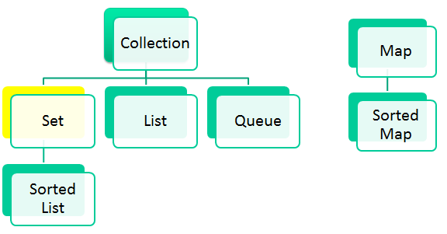
Set
A Set is an unordered Collection of unique elements (i.e., no duplicate elements).
This interface models the mathematical set abstraction and is used to represent sets, such as the cards comprising a poker hand, the courses making up a student's schedule, or the processes running on a machine.
The collections framework contains several Set implementations, including HashSet and TreeSet.
  HashSet stores its elements in a hash table (better performance)
  TreeSet stores its elements in a tree.
  (useful or potential sorting)
Notes:
Hash table > see http://www.youtube.com/watch?v=MfhjkfocRR0
Tree Structure (Binary) > http://www.youtube.com/watch?v=l0Z3E1n8kmk

Slide 40
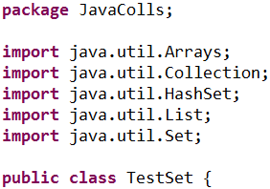
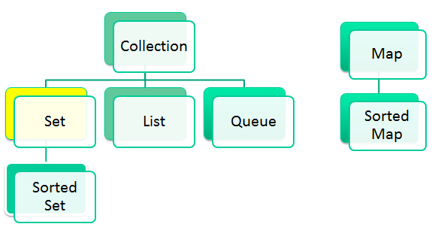
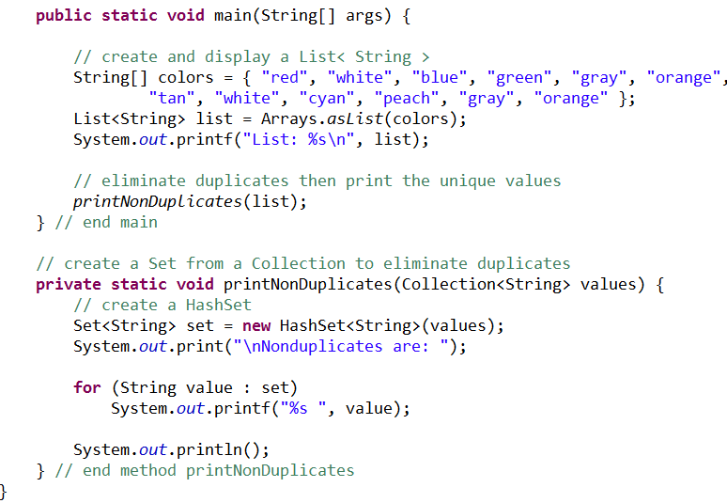
Set
Notes:
Program uses a HashSet to remove duplicate strings from a List. Recall that both List and Collection are generic types, so firstly a List is created that contains String objects, and is then passed as a Collection of Strings to method printNonDuplicates.
Method printNonDuplicates takes a Collection argument. Then a HashSet<String> is constructed from the Collection<String> argument. By definition, Sets do not contain duplicates, so when the HashSet is constructed, it removes any duplicates in the Collection.
A hash table stores information by using a mechanism called hashing. In hashing, the informational content of a key is used to determine a unique value, called its hash code.
The hash code is then used as the index at which the data associated with the key is stored. The transformation of the key into its hash code is performed automatically.

Slide 41
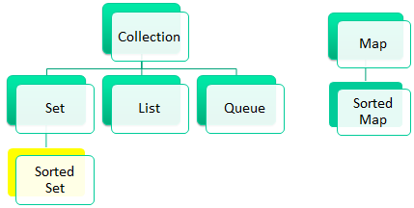
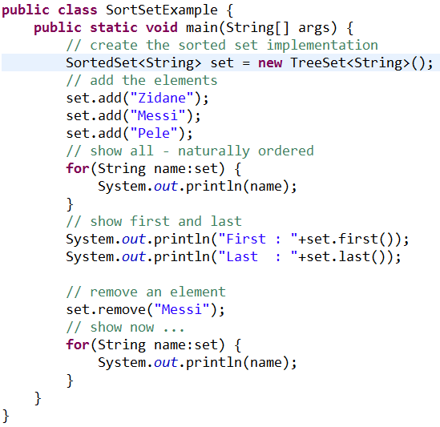
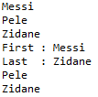
Sorted Set

Slide 42
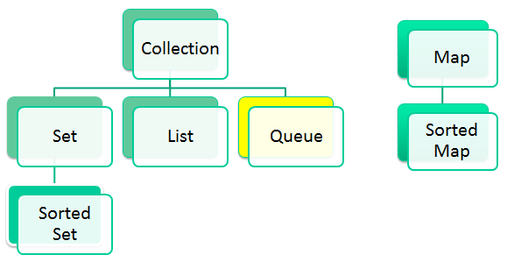
Queue
A collection used to hold multiple elements prior to processing. Besides basic Collection operations, a Queue provides additional insertion, extraction, and inspection operations.
Queues typically, but do not necessarily, order elements in a FIFO (first-in, first-out) manner.
Typically, insertions are made at the back of a queue and deletions are made from the front.
The queue retrieval operations — poll, remove, peek, and element — access the element at the head of the queue

Slide 43
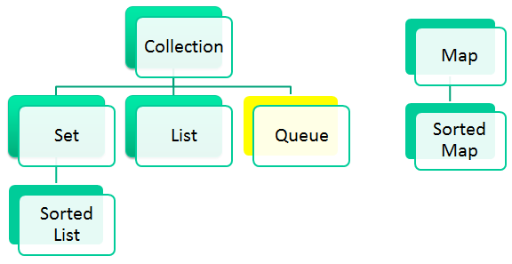
Queue
Queue Implementations
  LinkedList implements the Queue interface, providing first in, first out (FIFO) queue operations for add, poll, and so on.
  The PriorityQueue class is a priority queue based on the heap data structure. This queue orders elements according to the order specified at construction time, which can be the elements' natural ordering or the ordering imposed by an explicit Comparator.

Slide 44
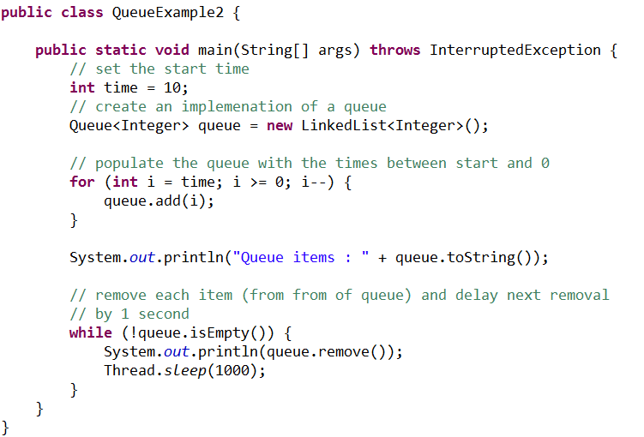
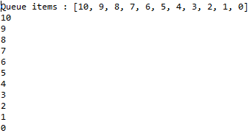
Queue

Slide 45
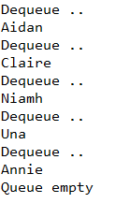
Queue exercise
Create an ArrayList of Strings to hold the names of five family members i.e. their names.
Convert to a queue
De-queue each name in 2 second intervals.
Notes:
package JavaColls;
import java.util.ArrayList;
import java.util.LinkedList;
import java.util.List;
import java.util.Queue;
public class QueueExercise {
public static void main(String[] args) {
List<String> list = new ArrayList<>();
// populate with the names of six family members
list.add("Aidan");
list.add("Claire");
list.add("Niamh");
list.add("Una");
list.add("Annie");
Queue<String> myQ = new LinkedList<>(list);
// dequeue every 2 seconds
while (!myQ.isEmpty()) {
System.out.println(myQ.poll());
try {
Thread.sleep(2000);
} catch (InterruptedException e) {
// TODO Auto-generated catch block
e.printStackTrace();
}
}
}
}

Slide 46
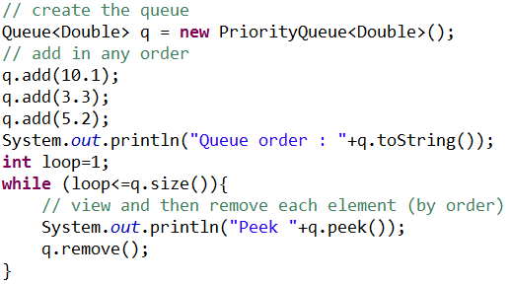

Queue
(PriorityQueue Class)
PriorityQueue : The head of the priority queue is the least element based on the natural ordering or comparator based ordering, if there are multiple objects with same ordering, then it can poll any one of them randomly. When we poll(peek) the queue, it returns the head object from the queue.
Notes:
Note : toString() method, uses the iterator, which is not guaranteed to respect the natural ordering. "The Iterator provided in method iterator() is not guaranteed to traverse the elements of the priority queue in any particular order.“

Slide 47
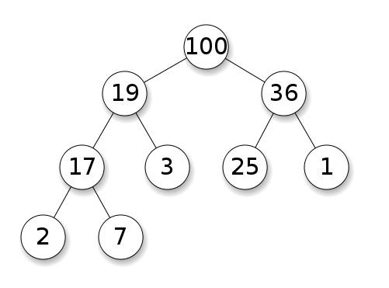

Heap data structure
Notes:
Main rule : Each parent node is larger than it’s two child nodes. See http://www.youtube.com/watch?v=v1YUApMYXO4

Slide 48
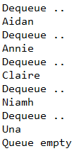
PriorityQueue exercise
Update the Queued exercise to order the names in the queue before de-queuing
Notes:
package demo;
import java.util.ArrayList;
import java.util.List;
import java.util.PriorityQueue;
import java.util.Queue;
public class PrioritQ {
public static void main(String[] args) {
List<String> list = new ArrayList<>();
// populate with the names of six family members
list.add("Aidan");
list.add("Claire");
list.add("Niamh");
list.add("Una");
list.add("Annie");
Queue<String> myQ = new PriorityQueue<>(list);
// dequeue every 3 seconds
while (!myQ.isEmpty()) {
System.out.println("Dequeue .. ");
System.out.println(myQ.poll());
try {
Thread.sleep(2000);
} catch (InterruptedException e) {
// TODO Auto-generated catch block
e.printStackTrace();
}
}
System.out.println("Queue empty");
}
}

Slide 49
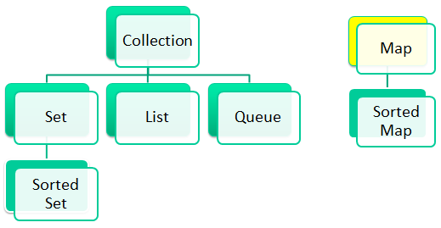
Map
Maps associate keys to values.
The keys in a Map must be unique, but the associated values need not be. If a Map contains both unique keys and unique values, it’s said to implement a one-to-one mapping. If only the keys are unique, the Map is said to implement a many-to-one mapping—many keys can map to one value.
Maps differ from Sets in that Maps contain keys and values, whereas Sets contain only values.

Slide 50
Map
Three of the several classes that implement interface Map are Hashtable, HashMap and TreeMap.
Hashtables and HashMaps store elements in hash tables.
TreeMaps store elements in trees.
Notes:
The HashMap class is roughly equivalent to Hashtable, except that the HashMap is unsynchronized and permits nulls

Slide 51
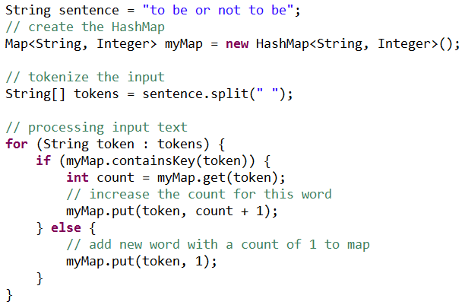
Map
Creating a HashMap and adding a key value pair.

Slide 52
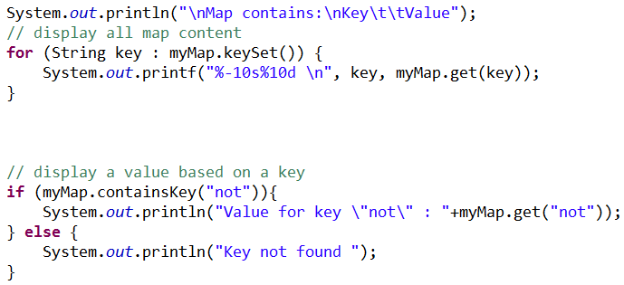
Map
Retrieve all keys and values.
Retrieve a value based on a key

Slide 53
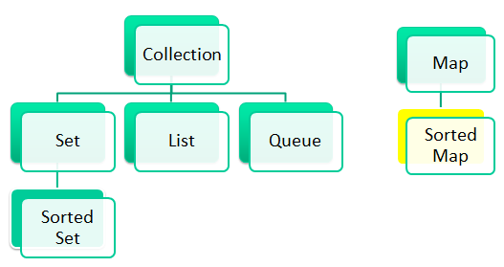
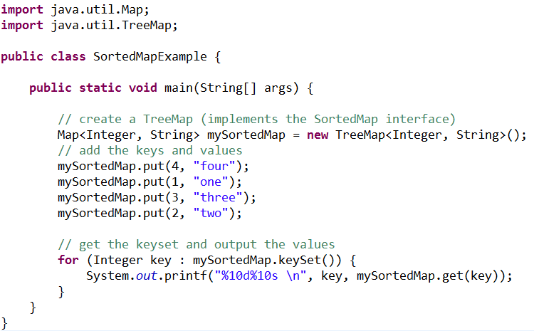
Sorted Map
Interface SortedMap extends Map and maintains its keys in sorted order - either the elements’ natural order or an order specified by a Comparator.
Class TreeMap implements SortedMap

Slide 54

Map exercise
Create a Map to store a telephone contacts list.
Notes:
import java.util.HashMap;
import java.util.Map;
public class Mapper {
public static void main(String[] args) {
Map<String, String> contacts = new HashMap<>();
contacts.put("Aidan", "07773939393");
contacts.put("Annie", "07722222222");
contacts.put("Una", "07788888888");
// get number
System.out.println("Number for Annie "+contacts.get("Annie"));
// get all
for (String key : contacts.keySet()){
System.out.println(key +" " +contacts.get(key) );
}
}
}

